Slide 1
Principles of Visualization
HUGEN 2073
Jon Chernus
Adapted from HJ Park’s slides with permission

Slide 2
good visualizations
bad visualization
bad
, probably?
Notes:
Today, we will discuss another component of visualization, color.
Then, we will go over what to consider in making good visualizations.

Slide 3
Why visualize? Two purposes in tension
Exploring
Discovering questions and answers (iteratively)
Making decisions
Finding patterns
Communicating
Presenting methods, arguments, conclusions, etc.
Recording these

Slide 4
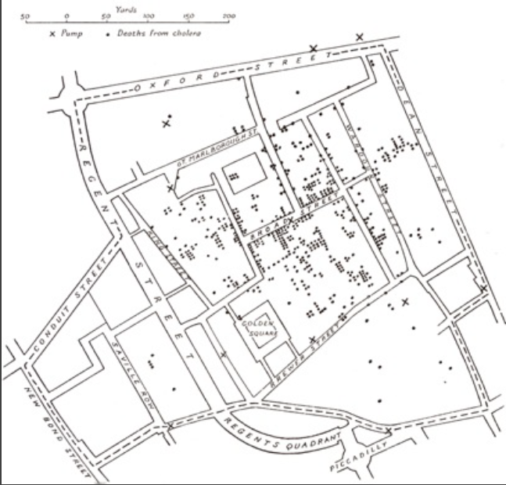
Example: exploring
The location of cholera deaths in central London, Sep. 1854
The Visual Display of Quantitative Information, E. Tufte, 2nd Ed. Graphics Press
Notes:
Dr. John Snow drew when he was interested in stopping the deaths in this neighborhood. Deaths were marked by dots. You were genuinely interested in the cause of the deaths. So Dr. Snow hypothesized that a water pump might be responsible for the deaths.

Slide 5
Example: exploring
The location of cholera deaths in central London, Sep. 1854
The locations of water pumps marked
An association between a water pump and the deaths
Help make decisions efficiently
The Visual Display of Quantitative Information, E. Tufte, 2nd Ed. Graphics Press
Notes:
To discover questions, Dr. John Snow, the drawer of this figure additionally marked the area’s eleven water pumps by cross. Examining the scatter over the surface of the map, Snow observed that cholera occurred almost entirely among those who lived near (and drank from) the Broad Street water pump. He had the handle of the contaminated pump removed, ending the neighborhood epidemic which had taken more than 500 lives.

Slide 6
Example: exploring
Anscombe’s Quartet: 11 (x, y) pairs
 | Group 1 |  | Group 2 |  | Group 3 |  | Group 4
 | X | Y | X | Y | X | Y | X | Y
1 | 10 | 8.04 | 10 | 9.14 | 10 | 7.46 | 8 | 6.58
2 | 8 | 6.95 | 8 | 8.14 | 8 | 6.77 | 8 | 5.76
3 | 13 | 7.58 | 13 | 8.74 | 13 | 12.74 | 8 | 7.71
4 | 9 | 8.81 | 9 | 8.77 | 9 | 7.11 | 8 | 8.81
5 | 11 | 8.33 | 11 | 9.26 | 11 | 7.81 | 8 | 8.47
6 | 14 | 9.96 | 14 | 8.1 | 14 | 8.84 | 8 | 7.04
7 | 6 | 7.24 | 6 | 6.13 | 6 | 6.08 | 8 | 5.25
8 | 4 | 4.26 | 4 | 3.1 | 4 | 5.39 | 19 | 12.5
9 | 12 | 10.84 | 12 | 9.13 | 12 | 8.15 | 8 | 5.56
10 | 7 | 4.82 | 7 | 7.26 | 7 | 6.42 | 8 | 7.91
11 | 5 | 5.68 | 5 | 4.74 | 5 | 5.73 | 8 | 6.89
Mean | 9 | 7.5 | 9 | 7.5 | 9 | 7.5 | 9 | 7.5
Variance | 9.1 | 3.4 | 9.1 | 3.4 | 9.1 | 3.4 | 9.1 | 3.4
Correlation | 0.81 |  | 0.81 |  | 0.81 |  | 0.81
Notes:
We also visualize to find patterns.
Anscombe’s Quartet comprises four datasets, each containing eleven (x,y) pairs. The essential thing to note about these datasets is that they share the same descriptive statistics such as mean, variance, and correlation. Mean of x is 9 and mean of y is 7.50 for each dataset.
Similarly, variance of x is 9.1 and variance of y is 3.4 for each dataset
The correlation coefficient (how strong a relationship is between two variables) between x and y is 0.816 for each dataset
Regression equation for each is Y = 0.5*X + 3.

Slide 7
Example: exploring
Anscombe’s Quartet: 11 (x, y) pairs
 | Group 1 |  | Group 2 |  | Group 3 |  | Group 4
 | X | Y | X | Y | X | Y | X | Y
1 | 10 | 8.04 | 10 | 9.14 | 10 | 7.46 | 8 | 6.58
2 | 8 | 6.95 | 8 | 8.14 | 8 | 6.77 | 8 | 5.76
3 | 13 | 7.58 | 13 | 8.74 | 13 | 12.74 | 8 | 7.71
4 | 9 | 8.81 | 9 | 8.77 | 9 | 7.11 | 8 | 8.81
5 | 11 | 8.33 | 11 | 9.26 | 11 | 7.81 | 8 | 8.47
6 | 14 | 9.96 | 14 | 8.1 | 14 | 8.84 | 8 | 7.04
7 | 6 | 7.24 | 6 | 6.13 | 6 | 6.08 | 8 | 5.25
8 | 4 | 4.26 | 4 | 3.1 | 4 | 5.39 | 19 | 12.5
9 | 12 | 10.84 | 12 | 9.13 | 12 | 8.15 | 8 | 5.56
10 | 7 | 4.82 | 7 | 7.26 | 7 | 6.42 | 8 | 7.91
11 | 5 | 5.68 | 5 | 4.74 | 5 | 5.73 | 8 | 6.89
Mean | 9 | 7.5 | 9 | 7.5 | 9 | 7.5 | 9 | 7.5
Variance | 9.1 | 3.4 | 9.1 | 3.4 | 9.1 | 3.4 | 9.1 | 3.4
Correlation | 0.81 |  | 0.81 |  | 0.81 |  | 0.81
Statistics is used to find patterns… but are summary stats enough?
Notes:
We also visualize to find patterns.
Anscombe’s Quartet comprises four datasets, each containing eleven (x,y) pairs. The essential thing to note about these datasets is that they share the same descriptive statistics such as mean, variance, and correlation. Mean of x is 9 and mean of y is 7.50 for each dataset.
Similarly, variance of x is 9.1 and variance of y is 3.4 for each dataset
The correlation coefficient (how strong a relationship is between two variables) between x and y is 0.816 for each dataset

Slide 8
Example: exploring

Slide 9
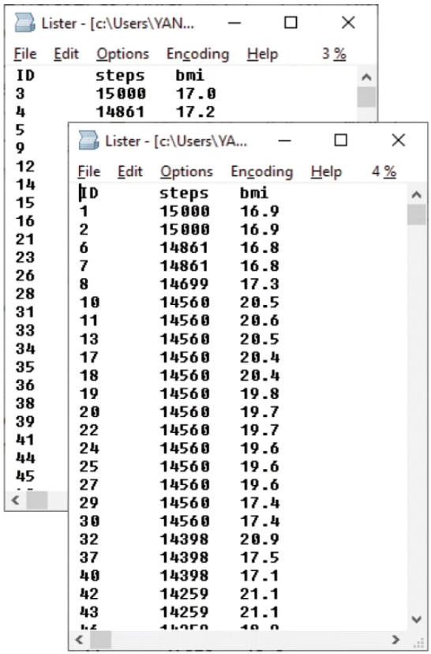
Example: exploring
The Gorilla Experiment:
an artificial dataset given to students with and without explicit hypotheses on the relationship between the variables
Yanai and Lercher, Genome Biology, 2020

Slide 10
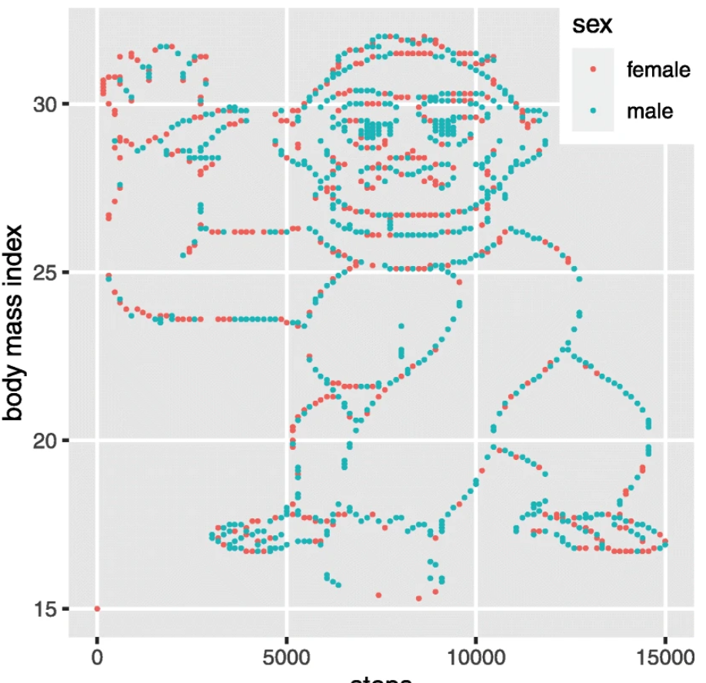
Example: exploring
The Gorilla Experiment
An artificial dataset given to students with and without explicit hypotheses on the relationship between the variables
Yanai and Lercher, Genome Biology, 2020

Slide 11
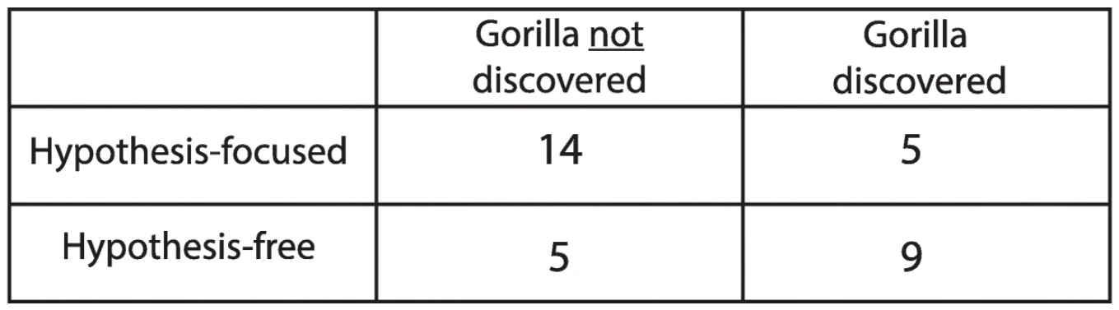
Example: exploring
The Gorilla Experiment
An artificial dataset given to students with and without explicit hypotheses on the relationship between the variables
Yanai and Lercher, Genome Biology, 2020

Slide 12
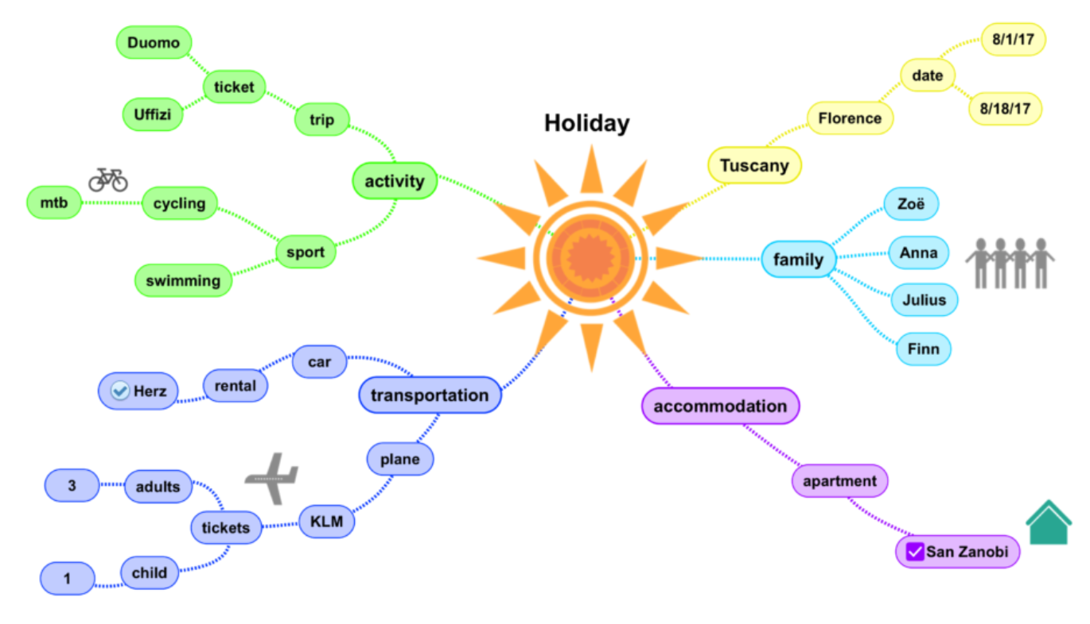
To explore? To present?

Slide 13
Good visualization has clear purposes in data science
The purpose of visualization
To explore
To analyze
To present
*Discover questions
*Make decisions
*Answer the questions
* Find patterns
*Present arguments
* Record
Intelligence and “shallowness”
Relative measure
of degree
Complexity and “depth”
Purpose transition
(explore -> analyze -> present)
Notes:
Data science consists of multiple steps, with different purposes for visualization at different steps.
Data scientists usually get data, enhance (the signal of ) the data, analyze the data, and present the data.

Slide 14
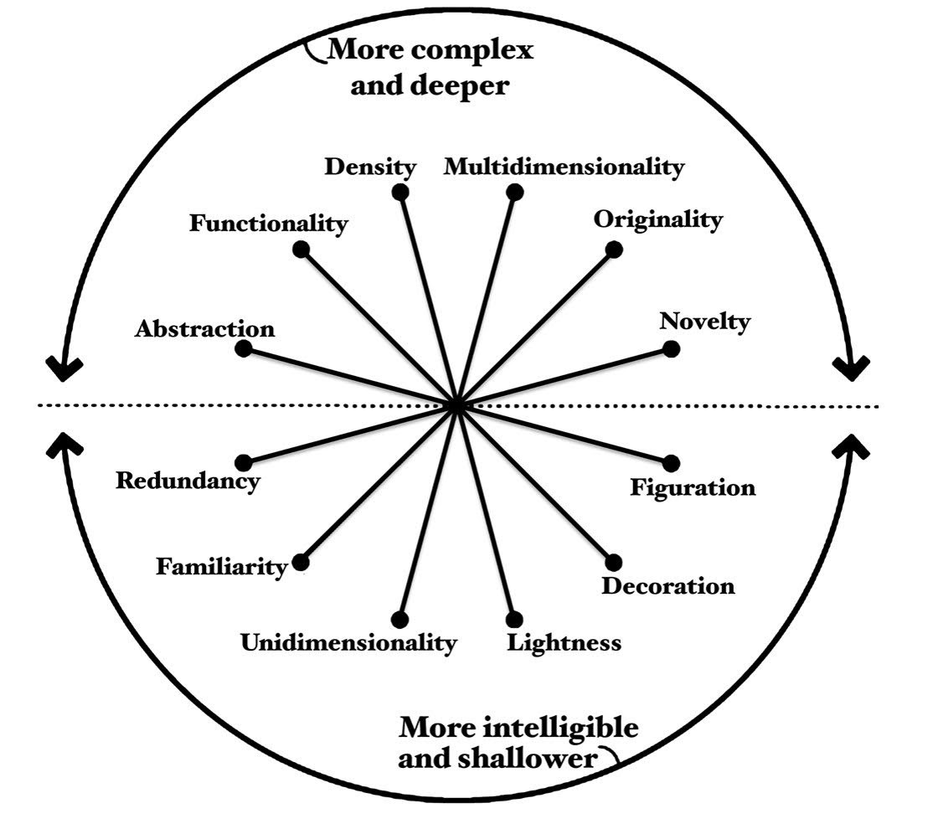
Tradeoffs in visualization
Cairo’s Visualization Wheel
Explore
Analyze
Present
Intelligence and Shallow
Relative measure
of degree
Complexity and Depth
Purpose transition
(explore -> analyze -> present)
https://ryanwingate.com/visualization/guidelines/visualization-wheel/
Notes:
The top half represents visuals which contain deep, complex data.
The bottom half represents visuals that provides accessible, but shallower, data.

Slide 15
The embedded “instructions” to read scientific visualization
The three “elements” of visualization
The spatial substrate
The graphics content
The graphics design
Figure-specific instructions will be discussed throughout the course for each figure style
Notes:
Next, we will discuss the elements of visualization.
In particular, we will discuss the spatial substrate, the graphical elements, and the graphical properties.

Slide 16
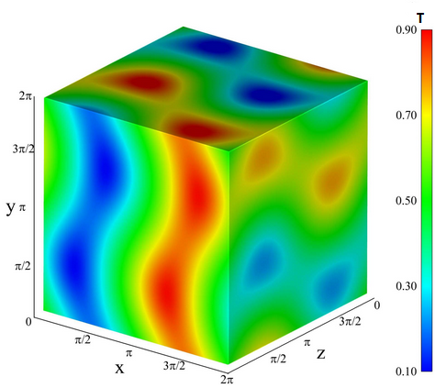
Spatial substrate
How space is used to represent data
2D along x-axis and y-axis
3D along x-, y-, and z-axis
4D along x-, y-, z-, and an additional axis (hard to understand)
Time?
Color?
https://i.stack.imgur.com/L0gVr.png
Notes:
The spatial substrate is the space in which we’re going to create our visualization.
The vast majority of information visualization takes place in 2-dimension space – along x and y axes.
However, it is possible to create 3-dimensional and even hyper-dimensional (more than 3-dimensions) representations too.
In theory, you can go 4D by adding one more layer of information.
In this example, besides x-, y-, and z-axis, there is one more layer of information encoded by color called T. However, interpreting 4D is not intuitive. For example, I cannot see how the colors change within this cube. So I will say 2D and 3D are our option.

Slide 17
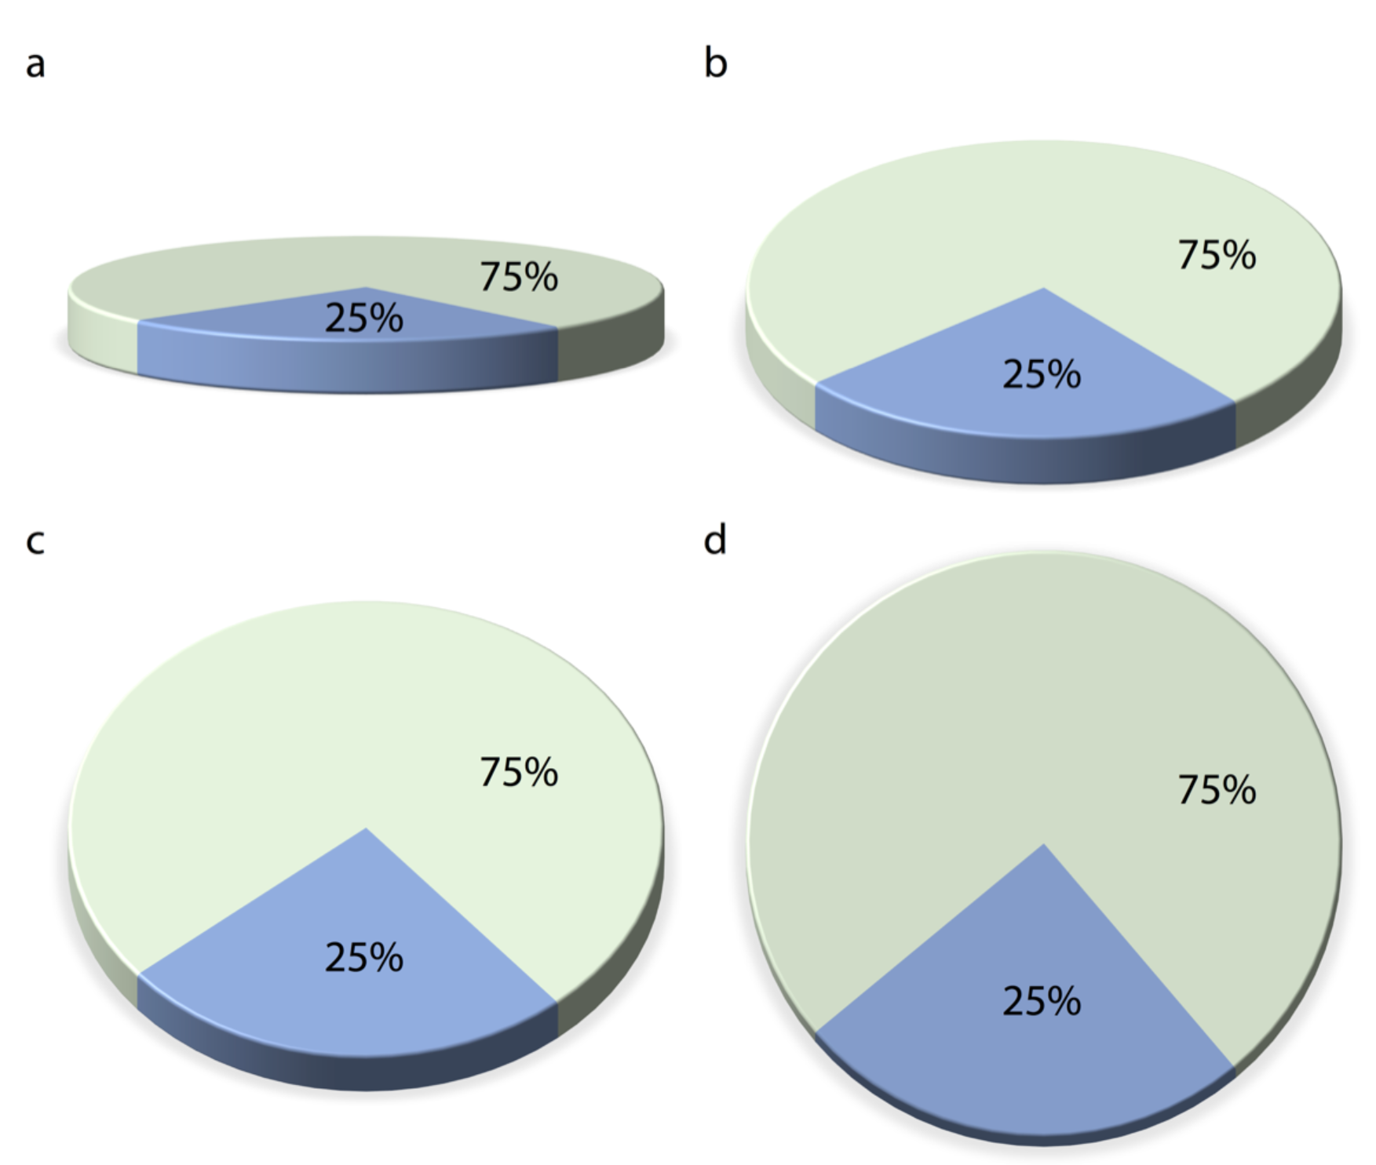
Implications for 3D
The same pie plot from four different angles
3D projected into 2D
The projection distorts the data and the human visual system cannot fully correct for the distortion
3-D often only to decorate – bad
Fundamentals of Data Visualization, Wilke, O’Reilly, 1st Ed.
Notes:
In the topic of spatial substrate, 3D plots are quite popular, in diverse disciplines such as business and even academics. However, they are almost always inappropriately used. It is rare that I see a 3D plot that couldn’t be improved by turning it into a regular 2D figure. All the problems are related to the fact that the 3D figure should always be projected into 2D to be read.
This example of 3-D pie chart has many problems.
First of all, a 2D pie chart can replace this 3D one. 3D is used simply to decorate and adorn the plot. I consider this use of 3D as gratuitous. It is unequivocally bad and should be erased from the visual vocabulary of data scientists.
Another problem with gratuitous 3D is that the projection from 3D to 2D distorts the data. The human visual system tries to correct for this distortion as it maps the 2D projection of a 3D image back into a 3D space. However, this correction can only ever be partial. This example pie chart has two slices, one representing 25% of the data and one 75%. As we change the angle at which we’re looking at the pie, the size of the slices seems to change as well. In particular, the 25% slice, which is located in the front of the pie, looks much bigger than 25% when we look at the pie from a flat angle.

Slide 18
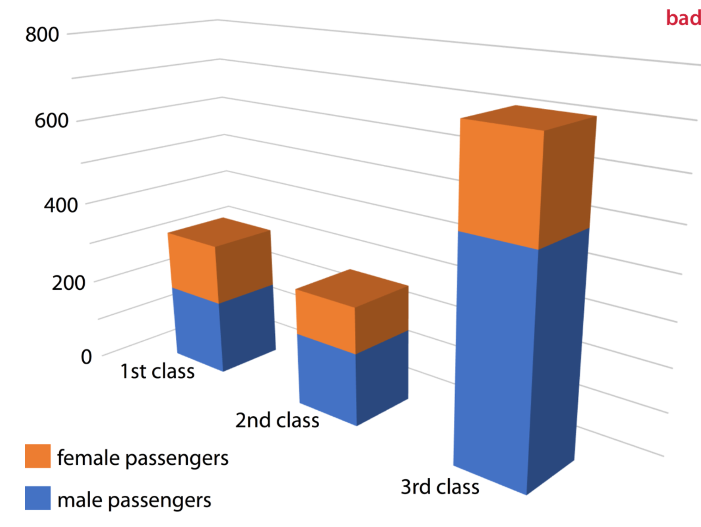
Implications for 3D
# of passengers on the Titanic
3D projected into 2D
The projection distorts the data and the human visual system cannot fully correct for the distortion
3-D often only to decorate – bad
Fundamentals of Data Visualization, Wilke, O’Reilly, 1st Ed.
Notes:
Similar problems arise for other types of 3D plot.
This 3D figure shows the breakdown of Titanic passengers by class and gender.
Because of the way the bars are arranged relative to the axes, the bars all look shorter than they actually are.
For example, there were 322 passengers total traveling in 1st class, yet Figure 26.2 suggests that the number was less than 300. This illusion arises because the columns representing the data are located at a distance from the two back surfaces on which the gray horizontal lines are drawn.

Slide 19
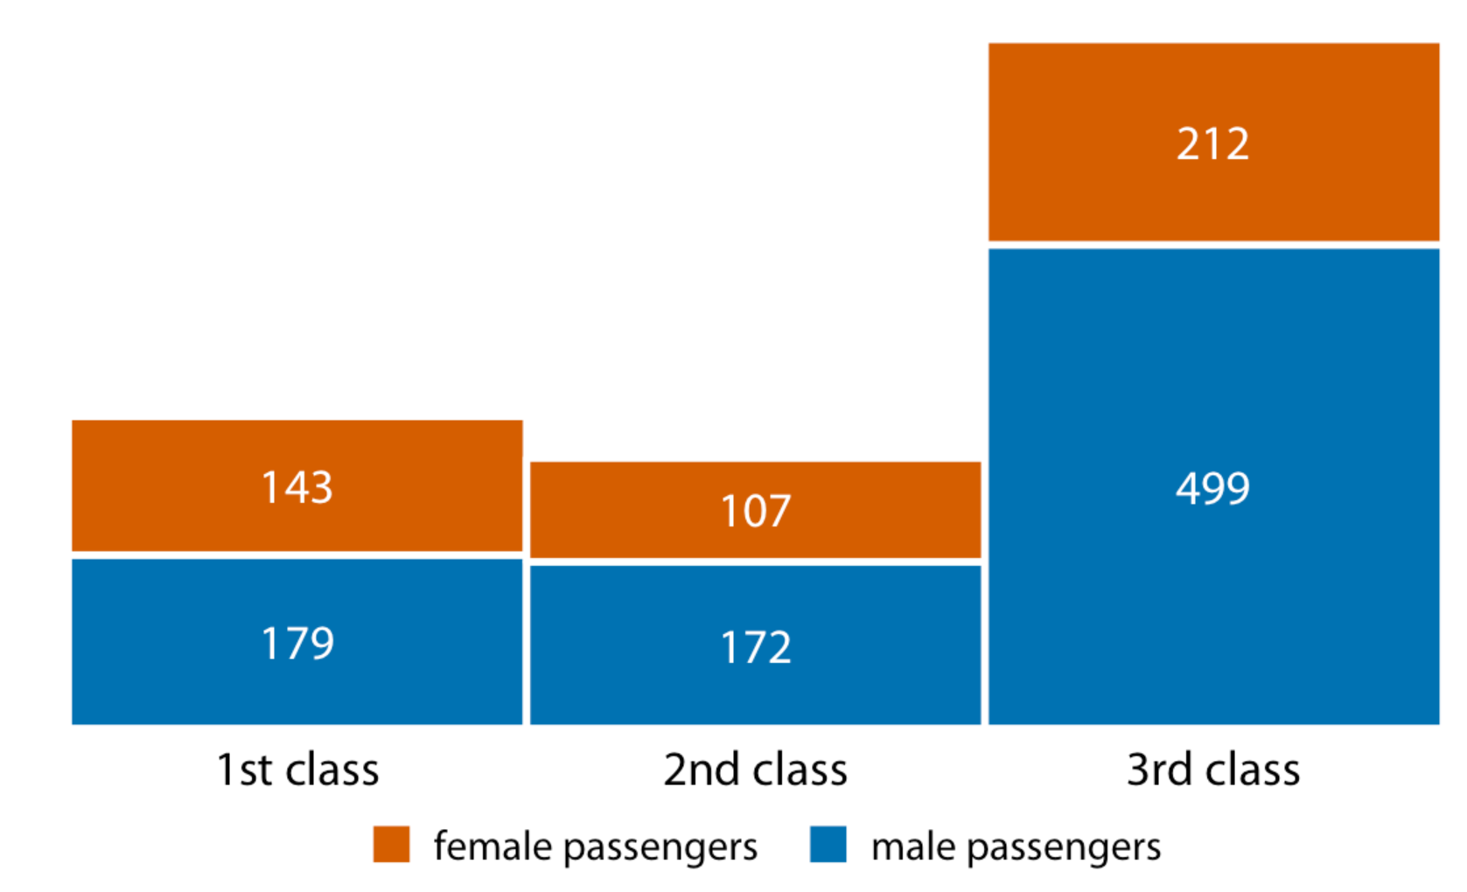
2D: generally better
# of passengers on the Titanic
Fundamentals of Data Visualization, Wilke, O’Reilly, 1st Ed.
Notes:
In this case, it is much better meaning easier to understand to use 2D.

Slide 20
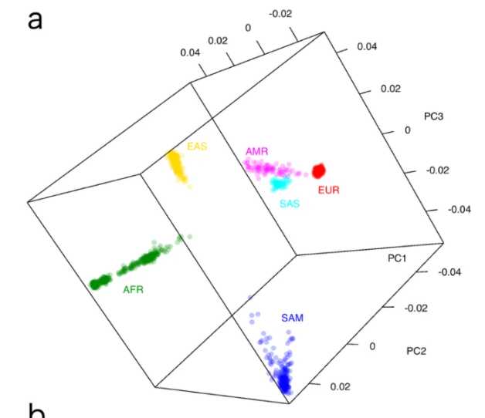
3D still sometimes helps
PCA plot on genome data of Samoan and other populations
Minster et al. Nat. Gen. 2016

Slide 21
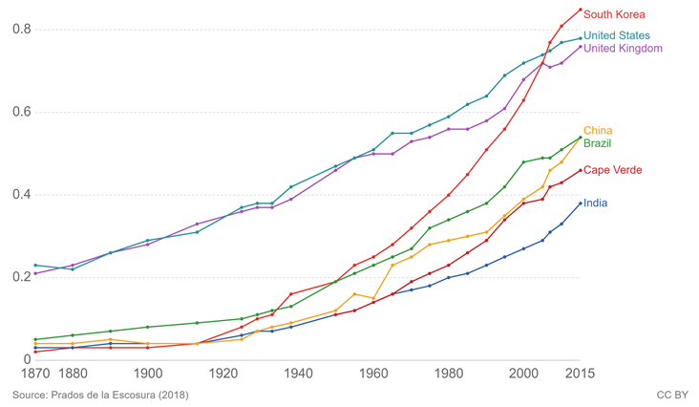
Graphics content (example)
Points to represent data, e.g.
Markers or colors to indicate different groups
Lines
Real line to represent trends
Notes:
Now we will discuss the graphic content.
The most essential element in any figure is points, because it represents the actual data.
In this example figure showing HIHD of multiple countries over years, points are real data that have been collected.
Sometimes, we use different markers or colors to indicate different groups of data points.
This figure didn’t employ multiple markers because the color-based differentiation is enough.
On the other hand, lines are many times not actual data.
They usually represent the trend we impose.
In this example, along the lines except for where points are located, they are not real.
They are just to show what might be the case based on a linear relationship within each year.

Slide 22
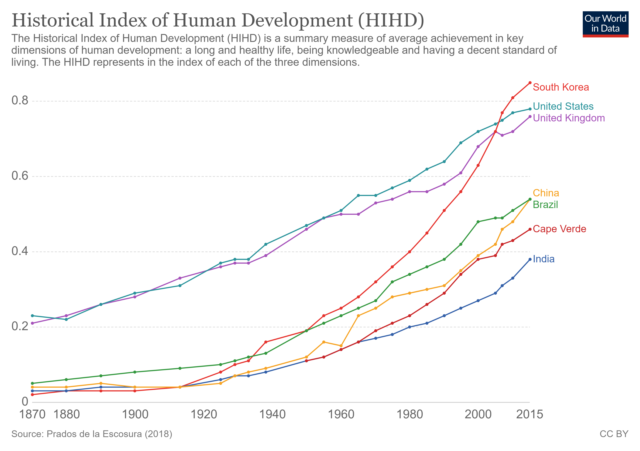
The graphics content
Points to represent data
Marker to indicate different groups
Lines
Real line to represent trends
Dotted line to help interpret the trends
e.g. HIHD at 1940
Arrow when there is directionality
Shapes to highlight an area
Notes:
We add shapes when we want to highlight an area.
Now, I am saying that my focus is the times from 1980 to 2015.
Actually, I don’t like my selection of colors here. We will discuss about colors in the next session.

Slide 23
The graphics content
Points to represent data
Marker to indicate different groups
Lines
Real line to represent trends
Dotted line to help interpret the trends
e.g. HIHD at 1940
Arrow when there is directionality
Shapes to highlight an area
Notes:
We add shapes when we want to highlight an area.
Now, I am saying that my focus is the times from 1980 to 2015.
Actually, I don’t like my selection of colors here. We will discuss about colors in the next session.

Slide 24
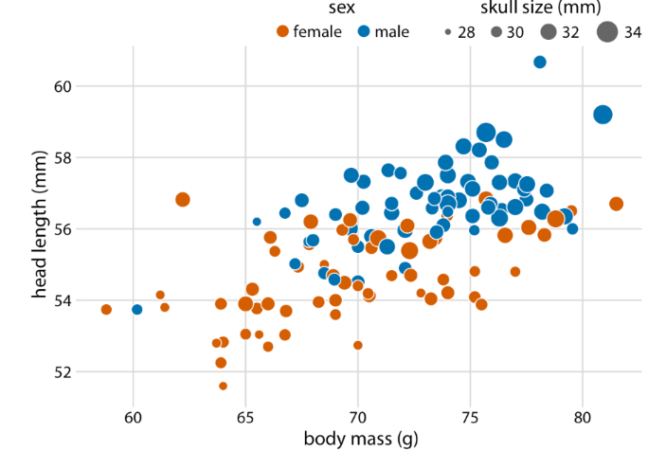
Graphics design (example)
Bluejays found in Pittsburgh
X- and y-axis
Ticks, tick-labels and axis-labels
Needs units whenever applicable
Adapted from Fundamentals of Data Visualization, Wilke, O’Reilly, 1st Ed.
Notes:
This example plot shows head length of blue jays against the body mass broken up by sex and skull size.
I emphasize that for all numerical variables (body mass, head length, and skull size) the relevant titles not only state the variables shown but also the units in which the variables are measured. This is good practice and should be done whenever possible. Categorical variables (such as sex) do not require units. Similarly, the legend titles show that point coloring indicates the birds’ sex and point size indicates the birds’ skull size in millimeters.

Slide 25
Graphics design (example)
Bluejays found in Pittsburgh
X- and y-axis
Ticks and labels
Needs units whenever applicable
Adapted from Fundamentals of Data Visualization, Wilke, O’Reilly, 1st Ed.
Notes:
This example plot shows head length of blue jays against the body mass broken up by sex and skull size.
I emphasize that for all numerical variables (body mass, head length, and skull size) the relevant titles not only state the variables shown but also the units in which the variables are measured. This is good practice and should be done whenever possible. Categorical variables (such as sex) do not require units. Similarly, the legend titles show that point coloring indicates the birds’ sex and point size indicates the birds’ skull size in millimeters.

Slide 26
Graphics design (example)
Title (what the figure is about) and caption (what point it makes)
Notes:
The first thing you check for any figure is the figure title. The job of title is to accurately convey to the reader what the figure is about. And the job of caption is to show what point it makes. However, the figure title may not necessarily appear where you were expecting to see it.

Slide 27
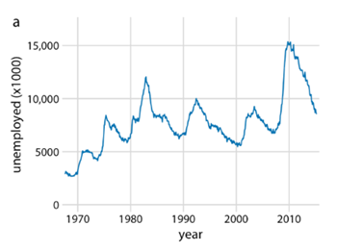
Graphics design (example)
# of unemployed persons in the US from 1970 to 2015
Across, title, caption, and labels
Check redundancy
U.S. Bureau of Labor Statistics
Notes:
Through x-axis label, we know that it is from 1970 to 2015.
The only new information in the title is “in the US”.
Due to the grammatical reason, I would have

Slide 28
Graphics design (example)
# of unemployed persons in the US from 1970 to 2015
Across, title, caption, and labels
Check redundancy
U.S. Bureau of Labor Statistics
Notes:
From the y-axis label, we know that it is the # of unemployed persons.

Slide 29
Graphics design (example)
# of unemployed persons in the US from 1970 to 2015
Across, title, caption, and labels
Check redundancy
U.S. Bureau of Labor Statistics
Notes:
Another thing we need to put eyes on is the redundancy in the title.
Does the title of this figure have redundancy, …?

Slide 30
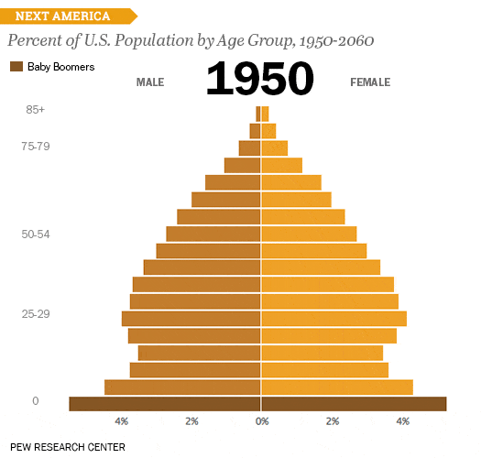
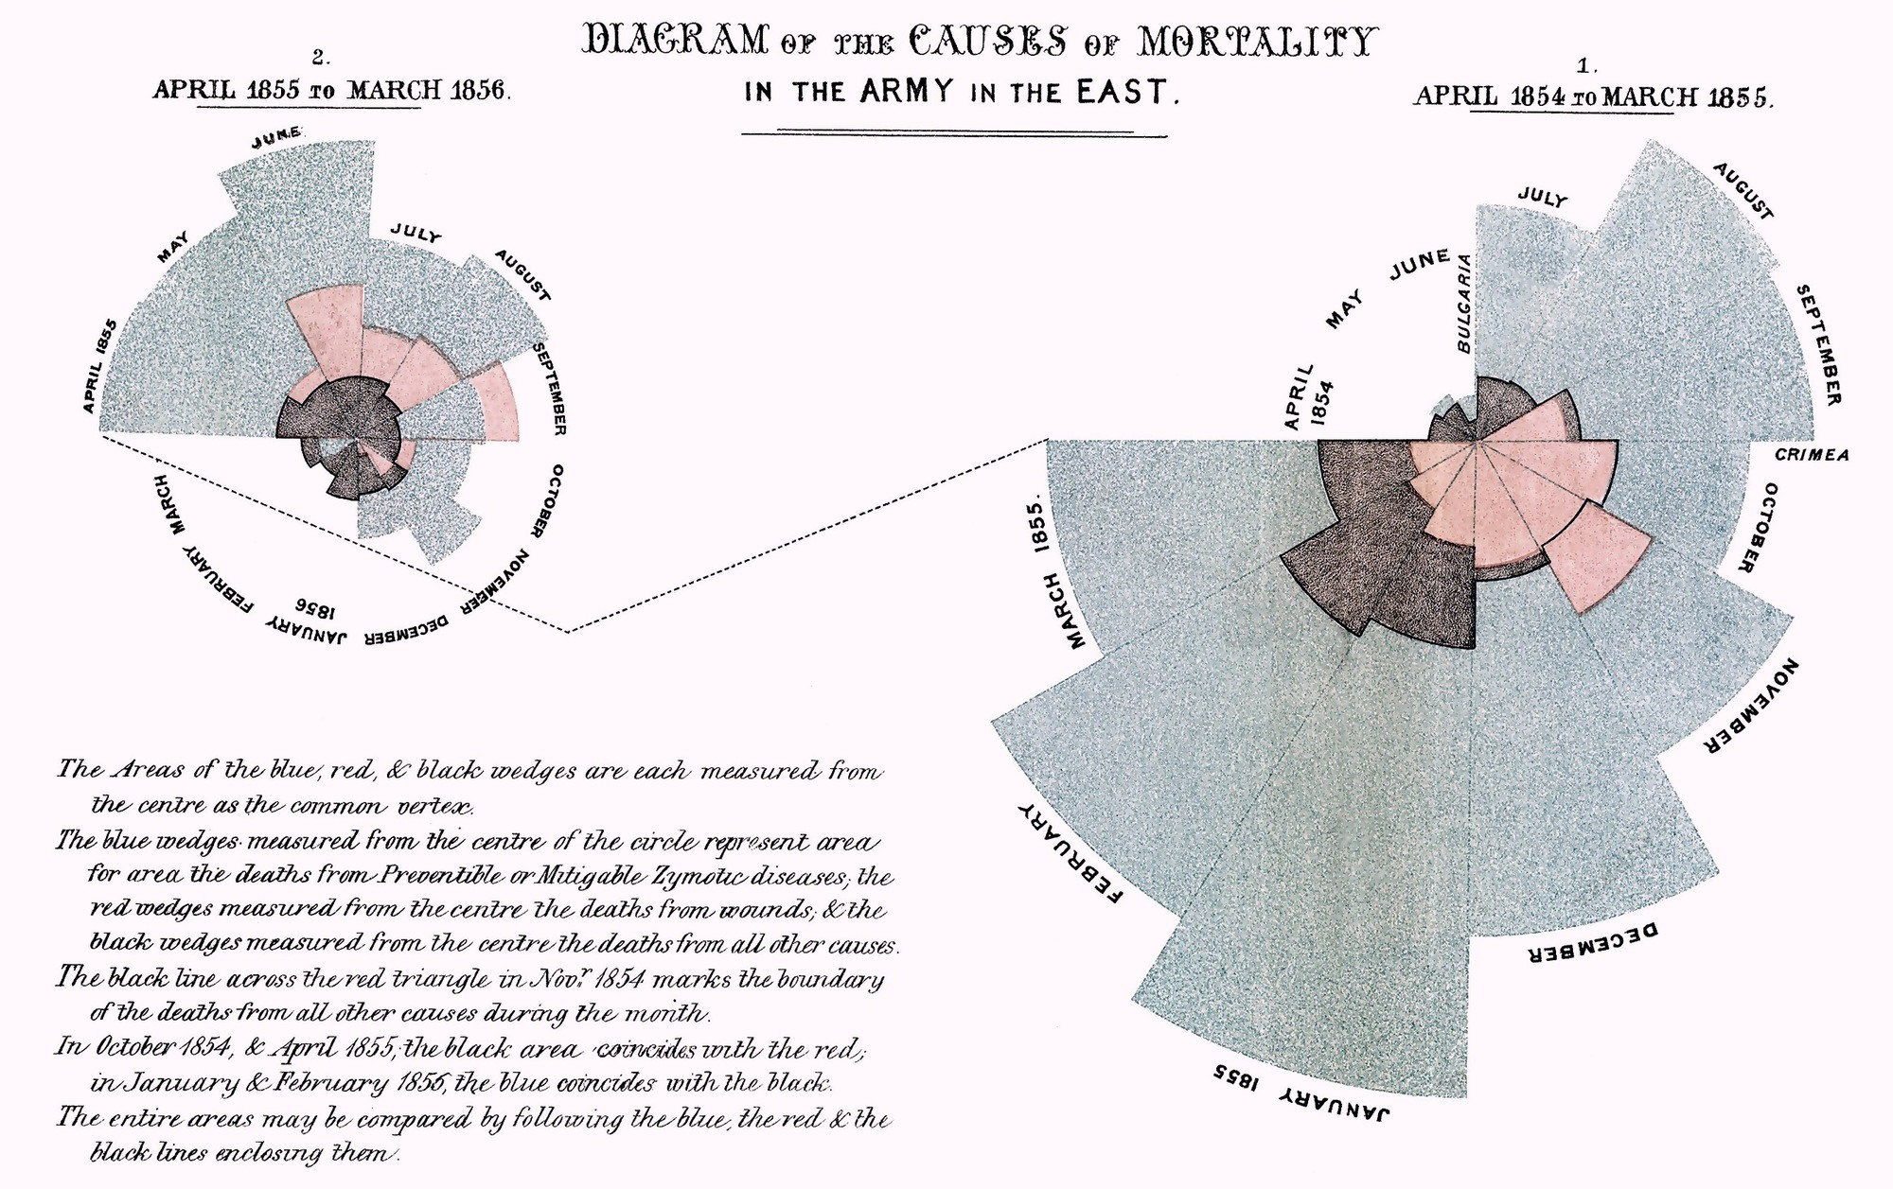
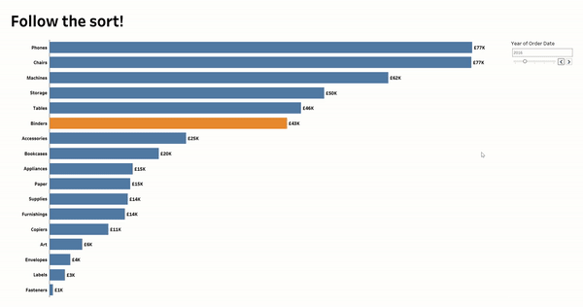
Example
Identify the visualization elements for each
Notes:
Sources:
https://www.tableau.com/learn/articles/best-beautiful-data-visualization-examples

Slide 31
Some principles for good visualizations
Choose substrate/content judiciously
Depends on data/variable type
We will discuss this indetail for many visualization/data types
Keep data-ink ratio high
Avoid clutter/“chartjunk”
Use color judiciously
Avoid deception
Highlight your message/have a clear purpose!
Don’t trust the defaults

Slide 32
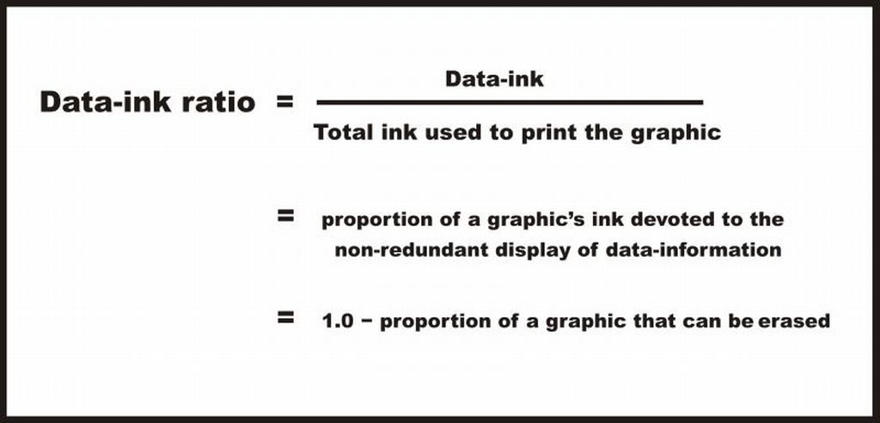
Good visualization keeps the data-ink ratio high
“Above all else, show the data.”
-Edward Tufte, 1983
(=the non-erasable core of a graphic)
= proportion of the non-erasable core of a graphic
= amount of information/amount of attention needed
https://infovis-wiki.net/wiki/Data-Ink_Ratio
Notes:
https://medium.com/plotly/maximizing-the-data-ink-ratio-in-dashboards-and-slide-deck-7887f7c1fab
Once referred to by the New York Times as the “Leonardo da Vinci of data,” the work of data visualization expert Edward Tufte has long been an inspiration to Plotly.
One of Tufte’s key principals is that good graphics present their message as simply as possible. To do this, he defined the “data-ink ratio” to turn this ‘so called’ simplicity into more practical ideas.
Because the non-erasable portion of a graph is subjective, Tufte follows up his principal of data-ink with the Five Laws of Data-Ink:

Slide 33
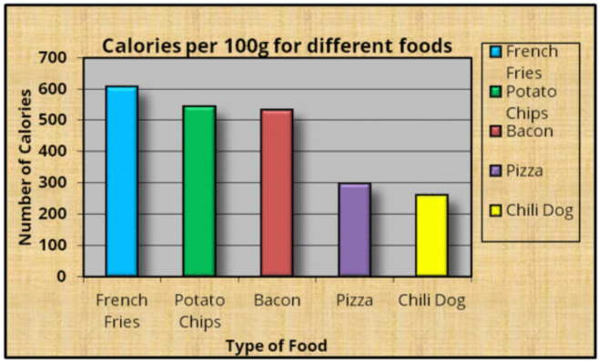
Exercise to maximize the data-ink ratio
Suppose the message is “bacon has more Calories than pizza or a chili dog but less than French fries and potato chips”
How to improve this figure?
https://www.darkhorseanalytics.com/blog
Notes:
Especially, let’s say we focus to compare Bacon with the other foods.

Slide 34
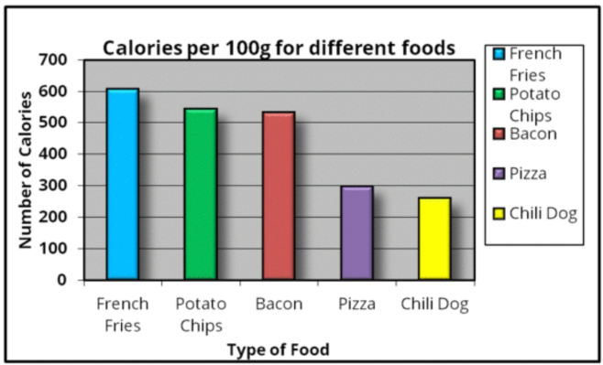
Exercise to maximize the data-ink ratio
https://www.darkhorseanalytics.com/blog
Notes:
Useless background

Slide 35
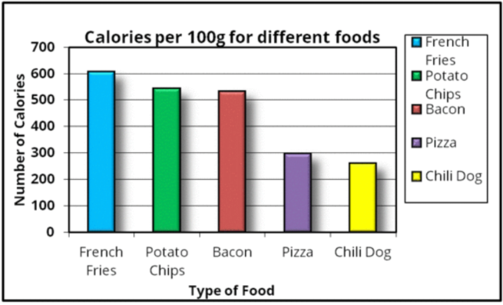
Exercise to maximize the data-ink ratio
https://www.darkhorseanalytics.com/blog
Notes:
More useless background

Slide 36
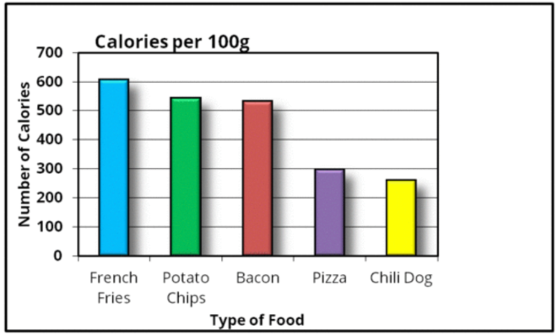
Exercise to maximize the data-ink ratio
https://www.darkhorseanalytics.com/blog
Notes:
Useless legend

Slide 37
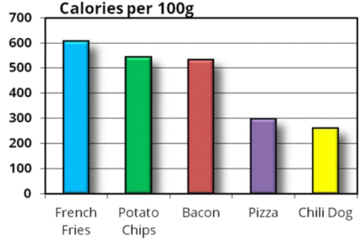
Exercise to maximize the data-ink ratio
https://www.darkhorseanalytics.com/blog
Notes:
Useless rectangle

Slide 38
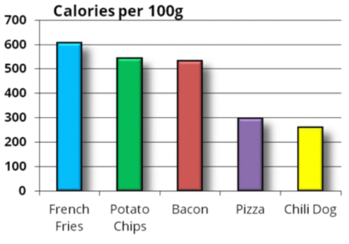
Exercise to maximize the data-ink ratio
https://www.darkhorseanalytics.com/blog
Notes:
Unnecessary heavy outline

Slide 39
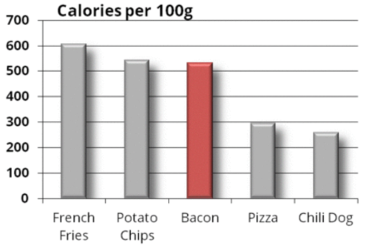
Exercise to maximize the data-ink ratio
Colors use more data-ink
https://www.darkhorseanalytics.com/blog
Notes:
Unnecessary color (remember message)

Slide 40
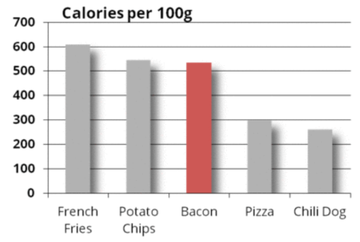
Exercise to maximize the data-ink ratio
https://www.darkhorseanalytics.com/blog
Notes:
Unnecessary 3D effect

Slide 41
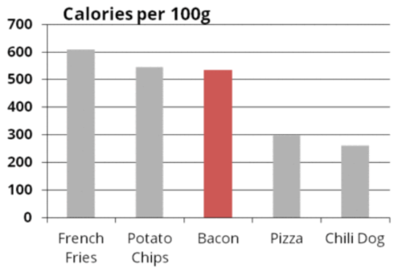
Exercise to maximize the data-ink ratio
https://www.darkhorseanalytics.com/blog
Notes:
Unnecessary shadow

Slide 42
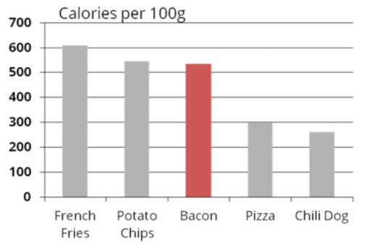
Exercise to maximize the data-ink ratio
https://www.darkhorseanalytics.com/blog
Notes:
Unnecessary bold

Slide 43
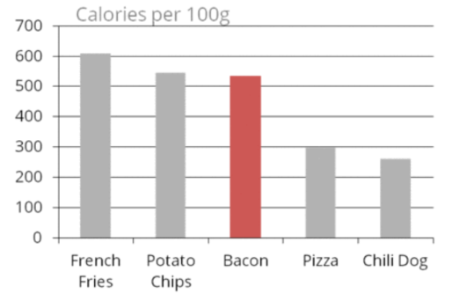
Exercise to maximize the data-ink ratio
https://www.darkhorseanalytics.com/blog
Notes:
Unnecessary bold

Slide 44
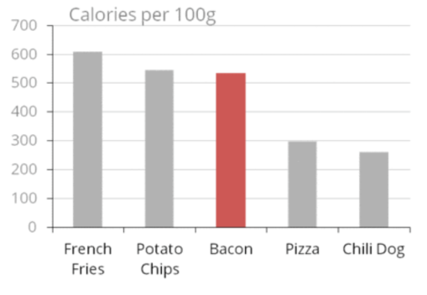
Exercise to maximize the data-ink ratio
https://www.darkhorseanalytics.com/blog
Notes:
Unnecessarily heavy horizontal lines

Slide 45
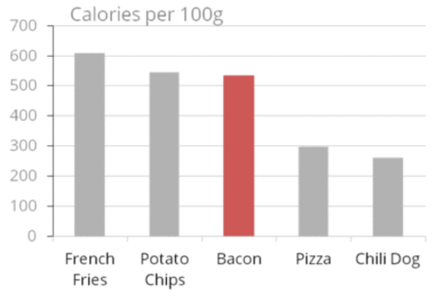
Exercise to maximize the data-ink ratio
https://www.darkhorseanalytics.com/blog
Notes:
Unnecessarily heavy x-axis

Slide 46
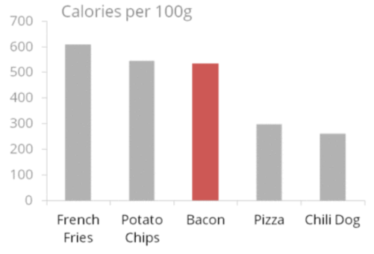
Exercise to maximize the data-ink ratio
https://www.darkhorseanalytics.com/blog
Notes:
Stop here? It becomes difficult to read y-axis values.

Slide 47
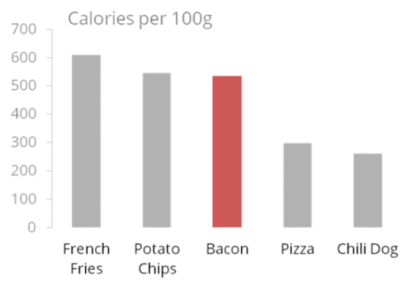
Exercise to maximize the data-ink ratio
https://www.darkhorseanalytics.com/blog
Notes:
Delete all axes? Again, probably too far

Slide 48
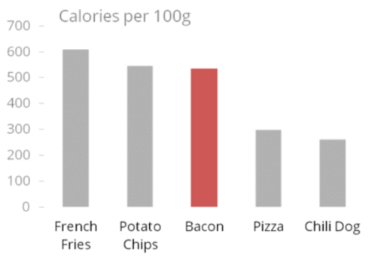
Exercise to maximize the data-ink ratio
https://www.darkhorseanalytics.com/blog
Notes:
Too far again

Slide 49
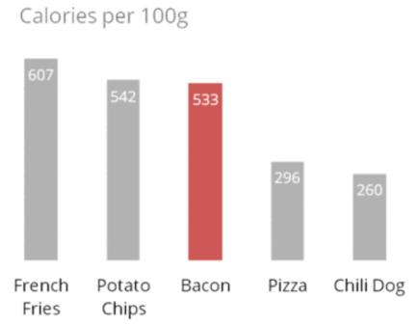
Exercise to maximize the data-ink ratio
https://www.darkhorseanalytics.com/blog
Notes:
Could basically show raw data – again, going too far.

Slide 50
Good visualization keeps the data-ink ratio high without losing information
Did we lose any information?
“Everything should be made as simple as possible, but no simpler” - Einstein

Slide 51
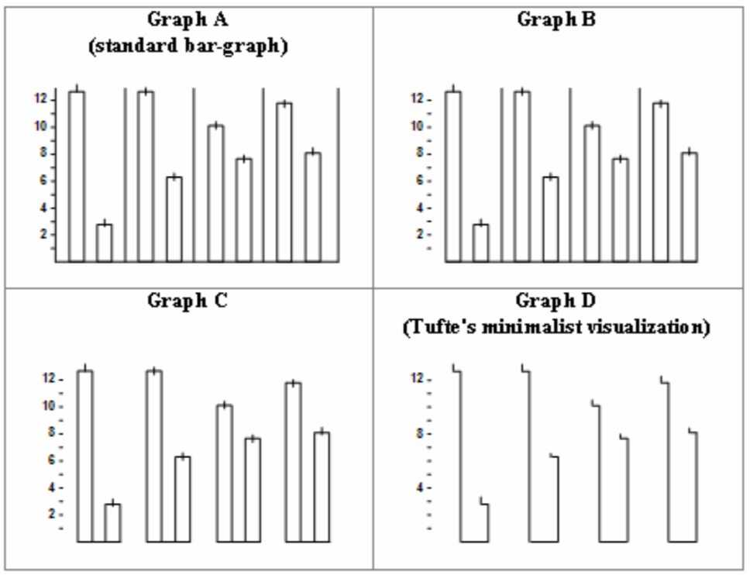
Let’s not go crazy with maximizing data-ink ratio!
Maximum data-ink ratio is not an absolute rule
E.g., Bar charts should have bars standing from 0.
The more important thing is balance
Inbar et al. Proceedings of the ECCE 2007 Conference, 28-31 August 2007, London, UK

Slide 52
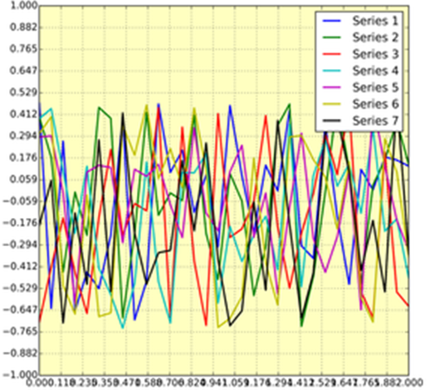
Good visualization avoids clutter
All the unnecessary visual elements that
Do not improve the message
Add confusion
E.g.
Too many lines of different colors
The legend overlaps the graphics content
Too many labels in the legend
Gratuitously colored background
Useless grid lines not helpful to understand
Gratuitously given x-axis and y-axis ticks
Rougier et al. Ten Simple Rules for Better Figures, PLoS Comp. Bio. 2014
Notes:
Chartjunk refers to all the unnecessary or confusing visual elements found in a figure that do not improve the message (in the best case) or add confusion (in the worst case). For example, chartjunk may include the use of too many colors, too many labels, gratuitously colored backgrounds, useless grid lines, etc. (see left part of Figure 7).
All the curves cover each other and the different colors do not help to distinguish them. The legend box overlaps part of the graphic, making it impossible to check if there is any interesting information in this area. There are far too many ticks: x labels overlap each other, making them unreadable, and the three-digit precision does not seem to carry any significant information. Finally, the grid does not help because (among other criticisms) it is not aligned with the signal, which can be considered discrete given the small number of sample points.

Slide 53
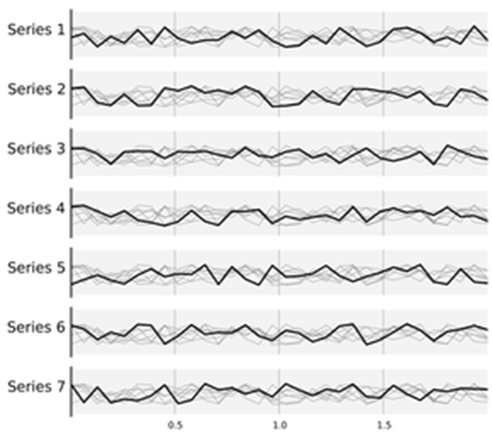
Good visualization avoids clutter
How does it improve the criticisms?
Too many lines of different colors
The legend overlaps the graphics content
Too many labels in the legend
Gratuitously colored background
Useless grid lines
Gratuitously given x-axis and y-axis ticks
What graphics design components does this lack?
Rougier et al. Ten Simple Rules for Better Figures, PLoS Comp. Bio. 2014
Notes:
On the other hand, the right figure shows seven plots, each of them showing one series, while other series are drawn very lightly behind the main one. Series labels have been put on the left of each plot, avoiding the use of colors and a legend box. The number of x ticks has been reduced to three, and a thin line indicates these three values for all plots. Finally, y ticks have been completely removed and the height of the gray background boxes indicate the [−1,+1] range (this should also be indicated in the figure caption if it were to be used in an article).
https://doi.org/10.1371/journal.pcbi.1003833.g007
However, an element that could be considered chartjunk in one figure can be justified in another. For example, the use of a background color in a regular plot is generally a bad idea because it does not bring useful information. However, in the right part of Figure 7, we use a gray background box to indicate the range [−1,+1] as described in the caption.

Slide 54
How to suit colors to purpose
If multiple data objects in the foreground,
Use complementary colors for contrast
Use analogous colors to accompany
Use triadic colors to compare 3 groups
Use split-complementary colors to highlight two groups

Slide 55
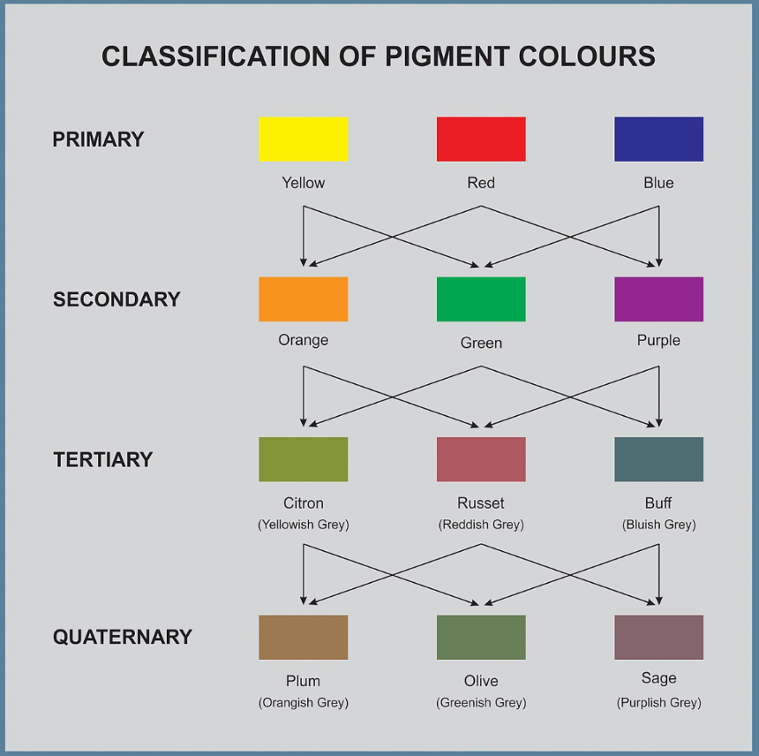
Degree of colors
Primary and secondary colors for most direct effect
Tertiary and quaternary for indirect effect
https://en.wikipedia.org/wiki/Color_theory/

Slide 56
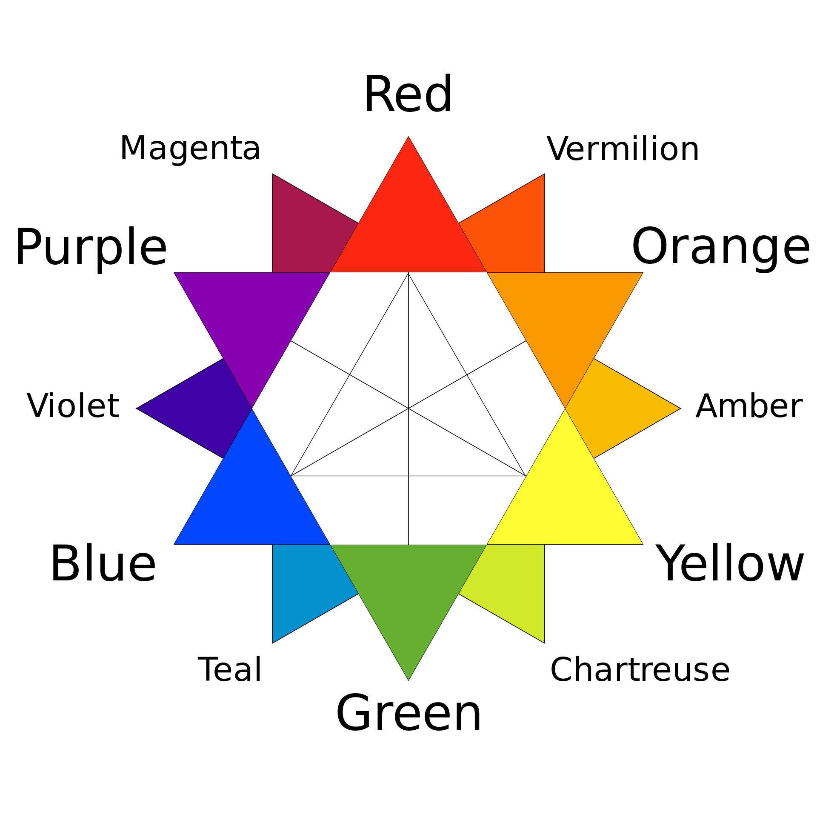
Degree of colors
Primary and secondary colors for most direct effect
Tertiary and quaternary for indirect effect
←A reference for color picking
https://en.wikipedia.org/wiki/Color_theory/

Slide 57
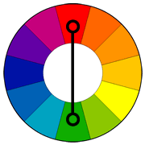
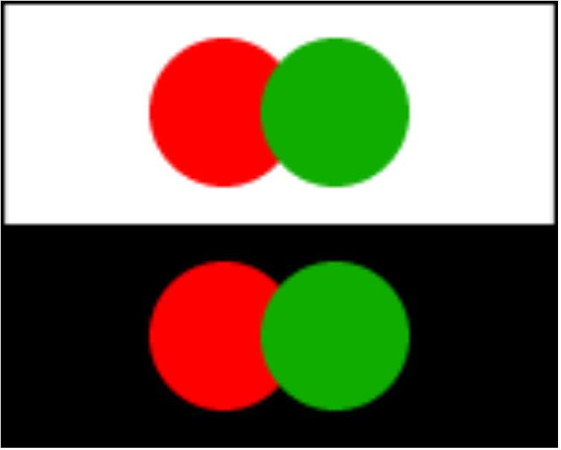
Use complementary colors to contrast
Colors oppose to each other
Create a vibrant look
Tricky to use in large doses
In scientific figures with two groups to contrast (e.g. good and bad genes)
https://www.tigercolor.com/color-lab/color-theory/color-harmonies.htm
Notes:
This is the color wheel based on the pigment color classification system. Colors that are opposite to each other on the color wheel are considered to be complementary colors
(example: red and green).
The high contrast of complementary colors creates a vibrant look especially when used at full saturation.
Complementary colors are tricky to use in large doses, but work well when you want something to stand out.
Complementary colors are really bad for text.

Slide 58
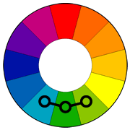
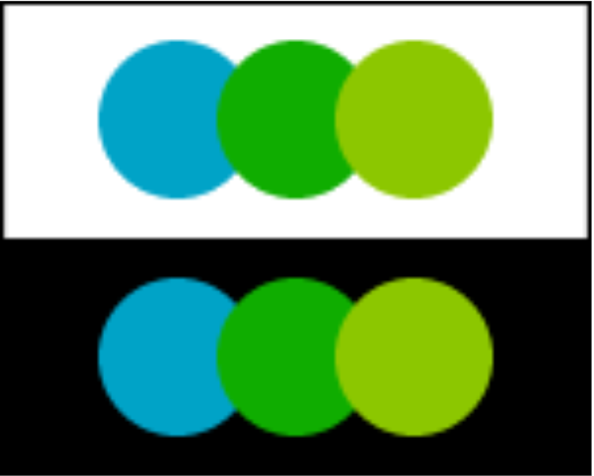
Use analogous colors to emphasize similarity
Colors next to each other
Create a serene look
Often found in nature
One to dominate, a second to support, the third as an accent
In scientific figures with multiple groups of similar attributes
https://www.tigercolor.com/color-lab/color-theory/color-harmonies.htm
Notes:
Analogous color schemes use colors that are next to each other on the color wheel. They usually match well and create serene and comfortable designs.
Analogous color schemes are often found in nature and are harmonious and pleasing to the eye.
Make sure you have enough contrast when choosing an analogous color scheme.
Choose one color to dominate, a second to support. The third color is used (along with black, white or gray) as an accent.

Slide 59
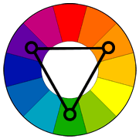
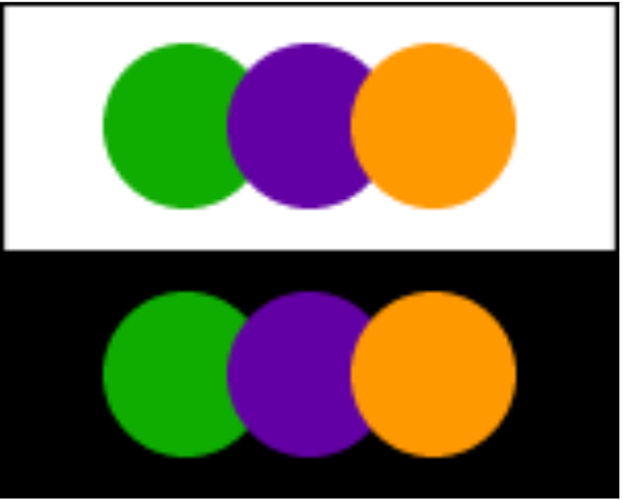
Use triadic colors to compare 3 groups
Colors evenly spaced
Create a vibrant look
One to dominate, the other two for accent
In scientific figures with multiple groups to compare of different attributes
https://www.tigercolor.com/color-lab/color-theory/color-harmonies.htm
Notes:
Triad A triadic color scheme uses colors that are evenly spaced around the color wheel.
Triadic color harmonies tend to be quite vibrant, even if you use pale or unsaturated versions of your hues.
To use a triadic harmony successfully, the colors should be carefully balanced - let one color dominate and use the two others for accent.

Slide 60
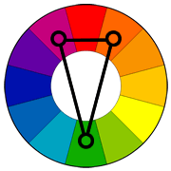
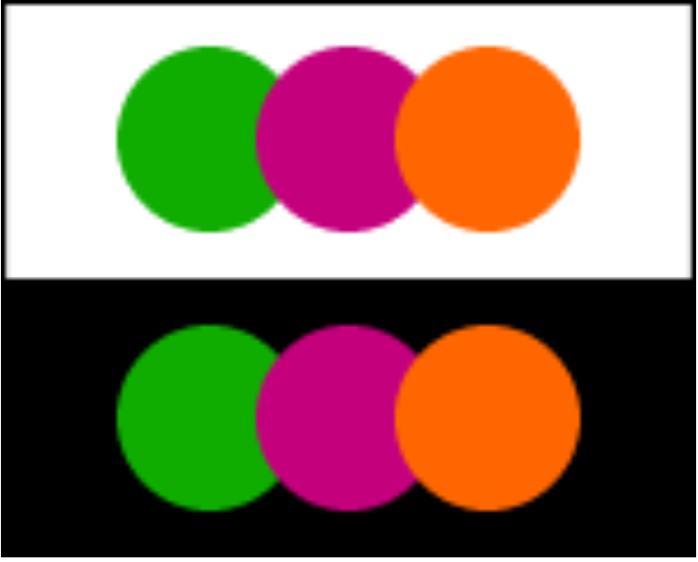
Use split-complementary colors to highlight two groups
A variation of the complementary color scheme
The base color + two complementary colors
Strong visual contrast with less tension
In scientific figures with multiple groups when comparing one to the other two
https://www.tigercolor.com/color-lab/color-theory/color-harmonies.htm
Notes:
Split-Complementary The split-complementary color scheme is a variation of the complementary color scheme. In addition to the base color, it uses the two colors adjacent to its complement.
This color scheme has the same strong visual contrast as the complementary color scheme, but has less tension.
The split-complimentary color scheme is often a good choice for beginners, because it is difficult to mess up.

Slide 61
How to match background and foreground colors
Background color matters for clarity and style
e.g.
Can you read this easily?
How about this one, then?
You can do better than this.

Slide 62
How to use colors for scientific figures
Colors to categorize
Colors to indicate ordinal values
Colors to indicate values and directionalities
Colors to highlight
Colorblind-friendly visualizations
Notes:
Let’s say you choose the right color.
How do you use colors?

Slide 63
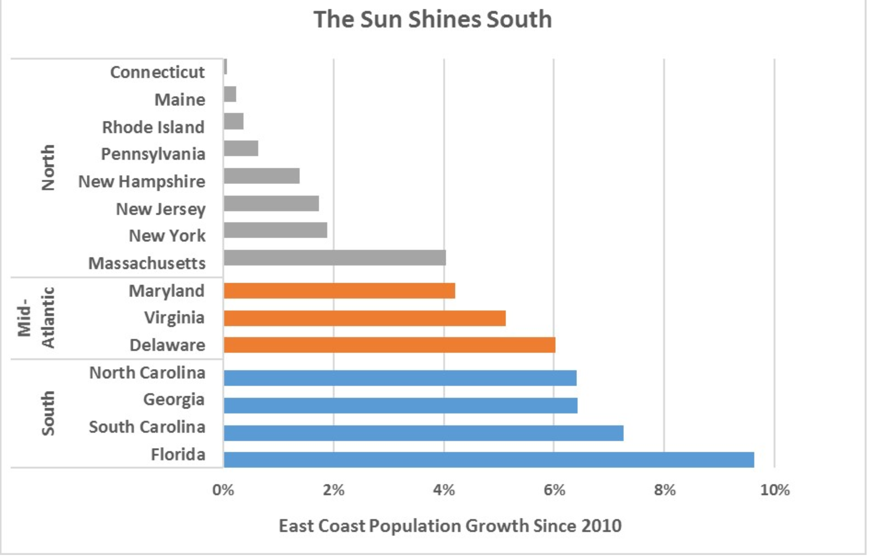
Colors to categorize
Growth trend shared by region
However, the presenter’s focus is not clear
Adapted from Decennial Census and 2016 State Population Estimates
Notes:
This figure, which I got from .., shows the population growth in the east coast cities since 2010, ranging from south side cities to north side.
This figure conveys one message.
When you sort the cities in the order of the growth, those in the same regions have experienced similar population growth.
I think the presenter successfully brought that to our attention.
I also think the presenter put more focus on the south based on the title.
Then, let me ask does this figure do a good job highlighting the south?

Slide 64
Colors to categorize
Coloring helps the categorization with the focus on Mid-Atlantic and South
Decennial Census and 2016 State Population Estimates
Notes:
How about this, coloring the regions differently?
It is better since you already had different groups of states in your mind.
And this coloring will help you differentiate the groups.
However, do you like these colors?
Can you identify which part the presenter wants to highlight even without reading the title?

Slide 65

Palette to categorize by color
https://python-graph-gallery.com/python-colors/
Categorical palette in matplotlib for categorical values
That have no ordinal relationship
Using more than 3 may lead to confusion
Notes:
In most of the programing languages for scientific figures, we don’t need to remember all the colors available.
They already put colors on your palette to categorize values.
To understand such a palette, we need to understand the meaning of categorical values.
What do we mean. by categorical values?
It means that there is no order among the values.
Accordingly, colors in these palettes won’t give you any orderings among the colors.
Another thing to remember is that if you use more than 6~7 colors simultaneously, the readers probably wouldn’t be able to remember which color represents what.

Slide 66

Colors to indicate ordinal values
Colors need to indicate
Which values are higher or lower
How distant two values from each other.
The color scale should vary uniformly
US Census Bureau
Notes:
On the other hand, we can also use colors to indicate ordinal values.
For that purpose, we need a sequence of colors that clearly indicate (i) which values are larger or smaller than which other ones and (ii) how distant two specific values are from each other. The second point implies that the color scale needs to be perceived to vary uniformly across its entire range.
This is median annual earnings by metropolitan area in the US. With this color scheme, it is clear that light blueish areas are lowest and these darkest area are highest. And you can place all the other areas in the middle by the colors.

Slide 67

Colors to indicate ordinal values
Colors need to indicate
Which values are higher or lower
How distant two values from each other.
The color scale should vary uniformly
http://www2.cs.uh.edu/~gnawali/courses/cosc6397-f13/intro-visualization.pdf
Notes:
This is a similar type of figure showing death rates of white males.
However, this is not as easy to understand as the other one.
Why?

Slide 68

Colors to indicate ordinal values
Good, in that we can see
which values are larger or smaller
how distant two values from each other (kind of)
Also good also because
of color psychology
it gives exact numbers
But it would be better if
the color scale were more distinguishable
the background were gray
http://www2.cs.uh.edu/~gnawali/courses/cosc6397-f13/intro-visualization.pdf
Notes:
How about this one? This meets the previous slides’ requirements.
This plot shows nationwide temperature of July 25 of 2010.
We can kinda see where it’s hotter and colder….
However, I don’t think this figure makes a good use of the current color scale.

Slide 69

Palettes to indicate ordinal values
https://python-graph-gallery.com/python-colors/
Sequential palette in matplotlib for ordinal values
Ordinal relationship
Spread evenly across
Notes:
Again, instead of remembering all the colors to use, we can simply use palettes designed for our purpose.
Order among the colors in the palette is rather clear.

Slide 70

Colors to indicate values and directionalities
Hypothetical example showing gene expression change (case vs. control)
https://blog.bioturing.com/2018/09/24/heatmap-color-scale/
Notes:
Some other times, we may want to represent values with the directionality.
This figure is called heatmap.
We will discuss this later in detail.
Basically, each row represents gene expression change across conditions.
0 means this gene expression stays the same as control, plus and minus means that it increases and decreases respectively.
In this example, the presenter probably wanted to say that there are positive and negative values in each direction with some degree.

Slide 71

Palettes to represent values and directionalities
https://python-graph-gallery.com/python-colors/
Diverging palette in matplotlib for ordinal values.
The middle/reference value should map to the “middle”/”neutral” color.

Slide 72
Colors to highlight
We wish to highlight the 3 rightmost points
Red is OK for doing that
Red is not OK when it is put with blue
The colors compete for attention
Notes:
Lastly, we use colors to highlight.
This is our figure for Anscombe’s quarter group 2.
And let’s say I want to highlight the rightmost 3 points.
So, given this default figure, I highlight them in red.
This is not an effective use of colors - why?
Because blue competes with read for attention. So the viewer wouldn’t be clear on which color I want to highlight.

Slide 73
Colors to highlight
This is better.
Clearly focuses attention on the highlighted points, without any distraction due to competing colors.
You need to set a clear focus before coloring!

Slide 74
Colors to highlight
How does the perceived message/focus change with different highlights?
Compare this and the following two versions of the same figure.
Decennial Census and 2016 State Population Estimates
Notes:
How about this, coloring the regions differently?
It is better since you already had different groups of cities in your mind.
And this coloring will help you differentiate the groups.
However, do you like these colors?
Can you identify which part the presenter wants to highlight even without reading the title?

Slide 75
Colors to highlight
Adapted from Decennial Census and 2016 State Population Estimates
Notes:
If the presenter’s intention was solely the South, I think this can work.

Slide 76
Colors to highlight
Adapted from Decennial Census and 2016 State Population Estimates
Notes:
And if the presenter’s intention was anything but the North, I think this can work.
As you can see, we use colors to indicate which data are of interest.

Slide 77

Colorblind-friendly visualizations
~ 8% of males and 0.5% of females suffer from some sort of color-vision deficiency
Less/not sensitive to green (deuteranomaly/deteranopia)
Less/not sensitive to red (protanomaly/protanopia)
Blue–yellow color-vision deficiency (tritanomaly/tritanopia)
Deuteranomaly is the most common form whereas tritanomaly is relatively rare
Sequential scales probably not a problem – gradient still clearly perceptible
Sequential
Fundamentals of Data Visualization, Wilke, O’Reilly, 1st Ed. (see chapter 19)
Notes:
Of these three, sequential scales will generally not cause any problems for people with color-vision deficiency (cvd), since a properly designed sequential scale should present a continuous gradient from dark to light colors. Figure 19.6 shows the Heat scale from Figure 4.3 in simulated versions of deuteranomaly, protanomaly, and tritanomaly. While none of these cvd-simulated scales look like the original, they all present a clear gradient from dark to light and they all work well to convey the magnitude of a data value.
“Figure 19.6: Color-vision deficiency (cvd) simulation of the sequential color scale Heat, which runs from dark red to light yellow. From left to right and top to bottom, we see the original scale and the scale as seen under deuteranomaly, protanomaly, and tritanomaly simulations. Even though the specific colors look different under the three types of cvd, in each case we can see a clear gradient from dark to light. Therefore, this color scale is safe to use for cvd.”

Slide 78


Colorblind-friendly visualizations
Diverging scales can be more difficult to make robust
Figure 19.7: A red–green contrast becomes indistinguishable under red–green cvd (deuteranomaly or protanomaly).
Figure 19.8: A blue–green contrast becomes indistinguishable under blue–yellow cvd (tritanomaly).
Notes:
Things become more complicated for diverging scales, because popular color contrasts can become indistinguishable under cvd. In particular, the colors red and green provide about the strongest contrast for people with normal color vision but become nearly indistinguishable for deutans (people with deuteranomaly) or protans (people with protanomaly) (Figure 19.7). Similarly, blue-green contrasts are visible for deutans and protans but become indistinguishable for tritans (people with tritanomaly) (Figure 19.8).

Slide 79

Colorblind-friendly visualization
The “original” on the bottom is more robust as a diverging scale
Slight modification
With help from simulators
Categorical scales can also be problematic. Use a web-based simulator.
https://davidmathlogic.com/colorblind/#%23D81B60-%231E88E5-%23FFC107-%23004D40
Notes:
With these examples, it might seem that it is nearly impossible to find two contrasting colors that are safe under all forms of cvd. However, the situation is not that dire. It is often possible to make slight modifications to the colors such that they have the desired character while also being safe for cvd. For example, the ColorBrewer PiYG (pink to yellow-green) scale from Figure 4.5 looks red–green to people with normal color vision yet remains distinguishable for people with cvd (Figure 19.9).

Slide 80

A wealth of colors to use in R or Python
Which colors to use for effective communication?
https://python-graph-gallery.com/python-colors/
Notes:
Most visualization packages in R or python provide a wealth of colors.
Among these many colors, you can see that some colors are more widely used, such as black, gray, red, ..
And some are not as much.
There are reasons about this.
Let’s see why we use certain colors more often than others

Slide 81

Color psychology?
Color can
Evoke emotions
Create impressions
e.g. red, blue, gray, black, green and brown
Help strengthen your argument
The meaning of colors may be context-specific.
Science does not necessarily share all the impressions.
https://www.greenapplelane.com/blog/logo-design-color-psychology
Notes:
Color can evoke an emotion, create a negative or positive impression in the reader’s mind, help clarify a position. It’s important to note that there is no such thing as a bad color – only the misuse of a color in certain situations. Most colors come with positive and negative associations and understanding color psychology and using it effectively in trial graphics will only strengthen your argument. Figure 1 below is a graphic we created to synthesize the color psychology research.

Slide 82

Same graphic with different colors creates different meanings
Store locations in red
predatory nature of company A
https://www.litigationinsights.com/best-colors-trial-graphics/
Notes:
This figure shows the locations of company A.
If you want to showcase the predatory nature of Company A, red is a good choice of color to portray the aggressive nature of the company as it seems to spread menacingly over the country.

Slide 83

Same graphic with different colors creates different meanings
The impression of the graphic shifted
Store locations in green
company growth and expansion
https://www.litigationinsights.com/best-colors-trial-graphics/
Notes:
Yet when you change the markers to green as in Figure 3, the impression of the graphic has shifted. The color in this graphic is now communicating company growth and expansion – a much more positive message for viewers. The same graphic with different colors can create different meanings.

Slide 84

Color misuse makes counter-intuitive figures

Slide 85

Good visualization reflects actual values
https://viz.wtf/post/169392205697/fewer-people-would-have-a-hard-time-giving-up

Slide 86

Good visualization follows assumptions
E.g., what is always assumed in a pie chart?
https://viz.wtf/post/162907112938/i-guess-its-best-to-show-all-the-data-and-use-a
Notes:
Figures also come with a set of assumption.
One of the assumptions for a pie chart is that slides in a pie add up to 100%.
It looks OK at the first glance despite a little too many words.
But if you care to add them up, you will see that they are more than 100%.
It violates the assumption of pie chart and cause confusion to readers.

Slide 87
Good visualization highlights your message
Matters more in presentation
Clearly identify the message first
Adapted from Decennial Census and 2016 State Population Estimates
Notes:
Characterizations of good visualization will assume that it is for presentation, since that purpose usually requires more attention.
A figure is meant to express an idea or introduce some facts or a result that would be too long (or nearly impossible) to explain only with words, be it for an article or during a time-limited oral presentation. In this context, it is important to clearly identify the role of the figure, i.e., what is the underlying message and how a figure could best express this message. Once clearly identified, this message will be a strong guide for the design of the figure, as shown in Figure 2. Only after identifying the message will it be worth the time to develop your figure, just as you would take the time to craft your words and sentences when writing an article only after deciding on the main points of the text.

Slide 88

Color helps focus our attention on the message
Davar et al. Science 2021
Is “Stable Disease” good or bad?

Slide 89
Do not trust defaults

Slide 90

Good visualization
Unlike in visual arts, there are clearly good and bad visualization in science.
Tufte in The Visual Display of Quantitative Information says:
Suggestion: when you make or see a figure,
always ask the purpose.
“Why am I making this figure?”
“In one sentence, what message am I trying to convey?”
“Why did the author bother including this figure?”

Slide 91
Visualization software/packages
Biorender
Cytoscape
Python (Matplotlib)
Inkscape, GIMP, Illustrator
TikZ, PGF
ImageMagick
D3.js
R/ggplot2
Tableau

Slide 92
https://imgs.xkcd.com/comics/painbow_award.png

